Slide 1
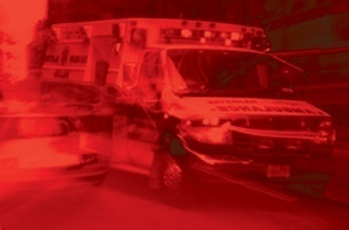
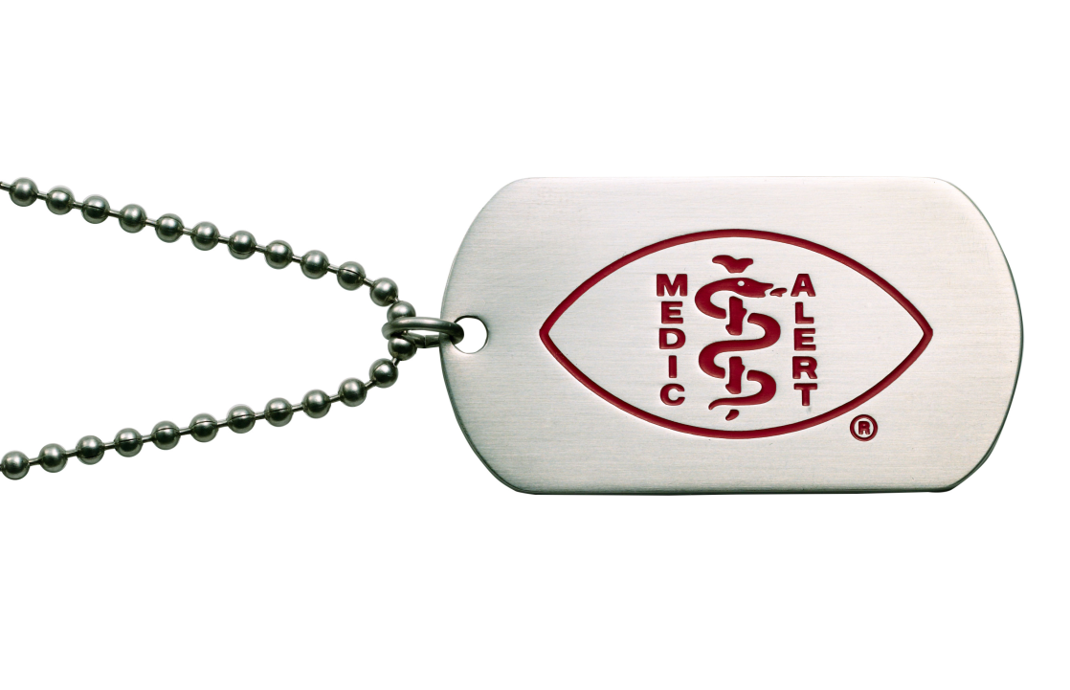
MedicAlert® Foundation
New Zealand Inc
Leading provider of Vital Personal Clinical Information in an Emergency
Notes:
The objective of this presentation is to:
1. Increased awareness, knowledge and skills of the educator and their students as it relates to MedicAlert Foundation NZ Inc.;
2. An increase in knowledge and skills related to how MedicAlert® can assist the emergency responder and support a member care in an emergency situation.
The above objective(s) will be accomplished through:
1. The identification and review of services provided by MedicAlert® ;
2. To increase the educators and participants How these services may be used on the job to support the role of First Responders, Emergency Health Care professionals, and Health Care Professional Educators.
At the end of the presentation participants will:
Recognize MedicAlert emblems and various MedicAlert medical identification products.
Understand how to use MedicAlert’s core services to the full potential
Understand range of conditions for which MedicAlert is used
Identify how MedicAlert may be used in common emergency situations
Learn how to integrate MedicAlert into emergency procedures
MedicAlert supports first responders and other health professionals by providing information on a member’s primary health conditions during an emergency.

Slide 2
MedicAlert® Foundation NZ Inc.
A Non Profit Charitable Trust
Providing emergency identification and medical information services for New Zealanders with medical conditions, allergies and when traveling abroad since 1962.
Over one hundred and thirty thousand members of all ages in New Zealand.
Over four million members worldwide, some of whom will visit New Zealand as tourists.
Notes:
MedicAlert Foundation background information.
Members requirements for MedicAlert services spans a range of health conditions, including allergies, asthma, diabetes, heart conditions and other chronic diseases as well as medications and personal needs.
The MedicAlert® services are designed to help the wearer of the emblem (a member) during an emergency situation. This can only happen if the emergency responders are aware of MedicAlert, its services and know how to use the services to the best benefit of the member. This training material reflects the mandate of MedicAlert Foundation to provide training and education to first responders and emergency health care professionals.
The training material will summarize the MedicAlert services. It will teach participants how to access the services and it will generate important notice of the MedicAlert services. This training material is not intended to solicit membership; it is for education purposes only.

Slide 3
MedicAlert® Patient Vitals Service
Immediate access to member’s Electronic Health Record –Patient Vitals by first responders and health professionals through the MedicAlert 24-hour Emergency Hotline that connects directly to a New Zealand Ambulance Call Centre.
Custom engraved emblems with medical information.
Personal Electronic Health Record –Patient Vitals.
MedicAlert Wallet Card with key medical information.
24-Hour Emergency Response Centre (hotline) accessible anywhere in the world when traveling.
Secure and confidential database holds member’s information.
Notes:
What MedicAlert offers as a service (Read the core services)
By providing both instant identification of medical conditions/special needs through the engraved medical ID and supporting information through electronic health records of patient vitals, the emergency hotline and membership card, these cores services work together to provide comprehensive protection when a member needs medical care.
MedicAlert® delivers vital personal information to the scene of an incident that can protect and save the patients life
This vital information also allows first responders to identify hazards that may otherwise be unknown and therefore allows first responders to also respond in a manner that is more diligent to protect their own personal health and safety. (e.g. HIV, AIDS, Hepatitis)

Slide 4
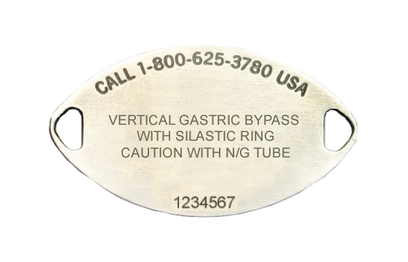
Using the MedicAlert® ID
Make it part of your initial assessment
Call the Hotline Number on the Emblem
NZ Ph. “+64 4 472 2999”
Emergency Response Hotline Phone Number
Medical Conditions
Membership #
Notes:
While MedicAlert is more then just a bracelet or necklet, using the MedicAlert ID is as simple as looking for it. MedicAlert should be included in your initial assessment when you arrive on scene.
While assessing the patient’s condition and need for treatment, a quick check of the wrists, neck and ankle area and shoes for a MedicAlert ID should be done. This is especially helpful in defining treatment when the patient cannot speak for themselves.
It is important to note that the MedicAlert bracelet and necklets are not pre-engraved, they are custom engraved to include each member’s primary health condition/special needs.
Information that cannot be included on the Emblem will be stored on an Electronic Health Record that is accessible 24/7.
Members also receive a Wallet card that provides additional medical information.
On the back of the emblem the following information is found:
The Emergency Response Hotline number at the top of the emblem;
The relevant medical information in the middle; and
The member’s membership number on the bottom.
First look at the medical condition engraved on the back of the MedicAlert ID. This will give you important information and alert you to course of treatment. If more information is required, make note of the hotline # and membership # for immediate use or for use by hospital staff.
In New Zealand MedicAlert®’s Hotline phone number connects directly to a New Zealand Ambulance Call Centre.

Slide 5
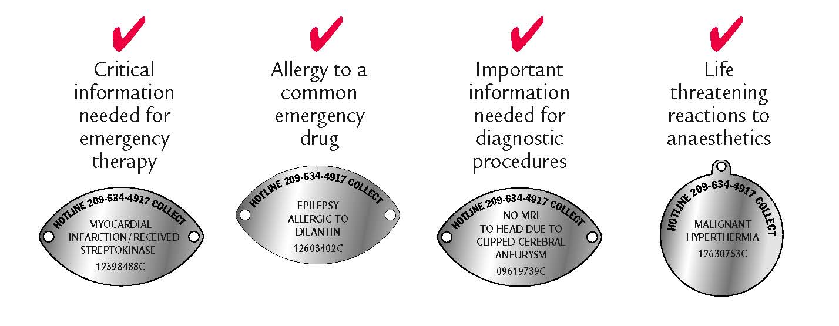
“MedicAlert Speaks for You”
Emergency Conditions…
Diabetes emergency, asthma attack, seizures, anaphylaxis
Communication impairments: deaf, mute, too young, too old, language barriers
But do you know about…
Notes:
Generally people recognize MedicAlert for these types of medical conditions.
It could be;
Diabetes emergency
Severe Asthma attack
Anaphylactic response
Confusion, Alzheimer’s
Seizures
Communication impairments: deaf, mute, too
young, too old, language barriers (travel)
Though the uses of MedicAlert medical identification is
not limited to these mentioned conditions.

Slide 6
Access to Emergency Response Centre
Member Identification
Medical conditions listed (interpret clinical abbreviations)
Allergies listed
Medications listed
Emergency contact information
Doctors contact information
Advanced Directives
Always notify Emergency Services that the Patient has a MedicAlert® Emblem when calling 111.
Notes:
The Emergency Response Centre can provide
Member Identification
Medical Conditions listed – This may include Doctors notes or directions held on file. Ask for assistance to interpret
standard clinical abbreviations engraved on the Emblem.
Allergies Listed – This may include anaphylaxis, food or drug allergies and/or adverse reactions
Medications listed – Doctor prescribed.
Emergency contact information – Not usually required by a first responder. Includes their next of kin or a welfare
enduring power of attorney.
Doctors contact details – This may include the patients regular General Practitioner, a specialist or hospital Doctor.
Advanced Directives lodged with MedicAlert®.

Slide 7
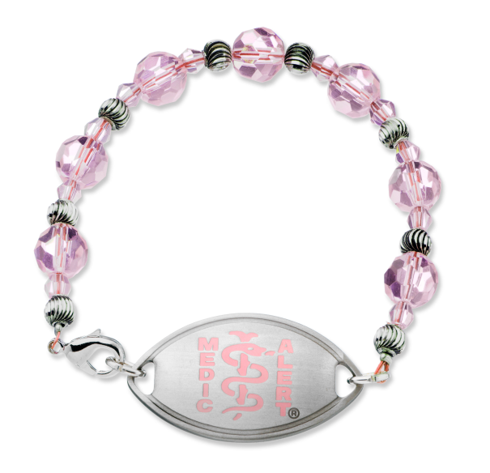
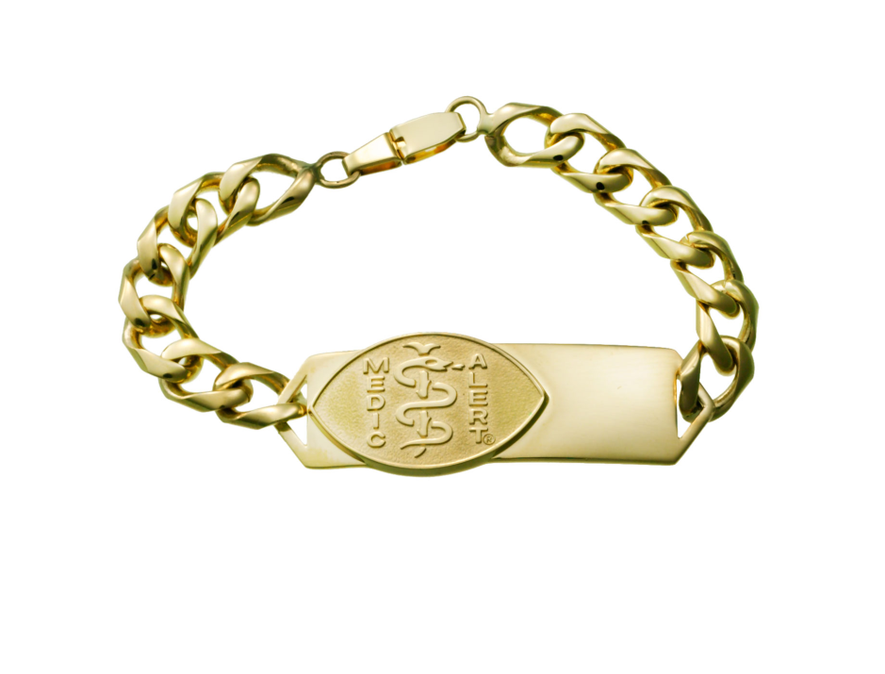
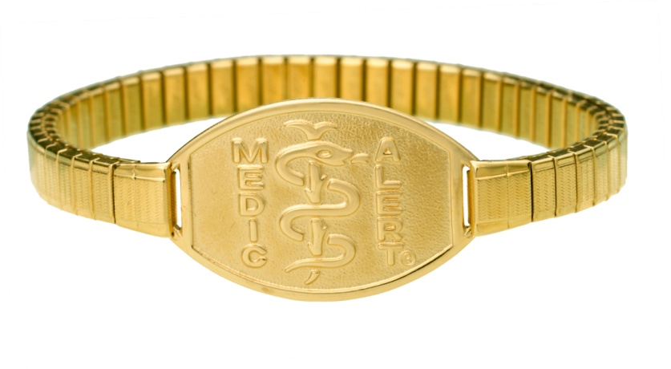
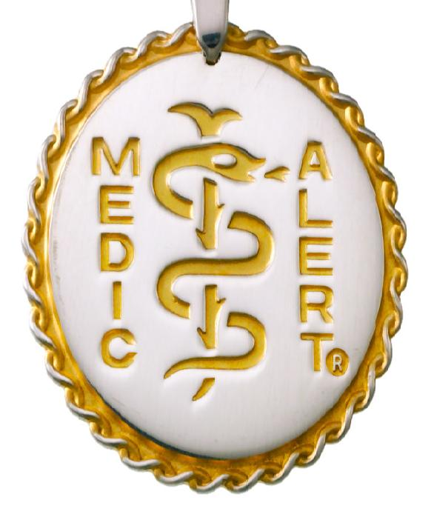
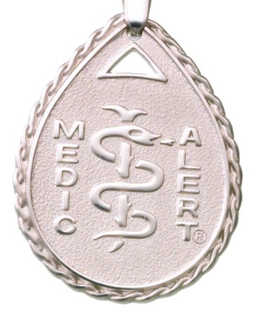
MedicAlert Emblem Identification
Always look for the MedicAlert Emblem – as bracelets and chains can vary
Notes:
These are some examples of medical identification products available through MedicAlert® in New Zealand .

Slide 8
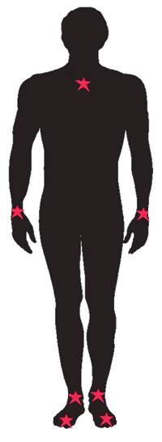
MedicAlert® identification can be found on the following locations.
Using the Identification
Neck
For MedicAlert Emblem Necklets and Dog Tags
Both Wrists
For MedicAlert Emblem Bracelets or Charms
Both Ankles
For MedicAlert Emblems worn as an Anklet
Both Shoes
For MedicAlert Shoe Tag (usually worn by patients with Autism)
Notes:
MedicAlert can be found on the following locations on the body. The above diagram indicates the areas of the body where an emblem could be located and therefore needs to be checked.
Neck
Wrist
Ankle area
MedicAlert® Internationally introduced a shoe tag in 2005 that is generally used for Members with Medical conditions the likes of Autism, or where a member works in a hazardous work environment such as a factory and therefore due to safety measures in the workplace is unable to wear a regular MedicAlert® Emblem.

Slide 9
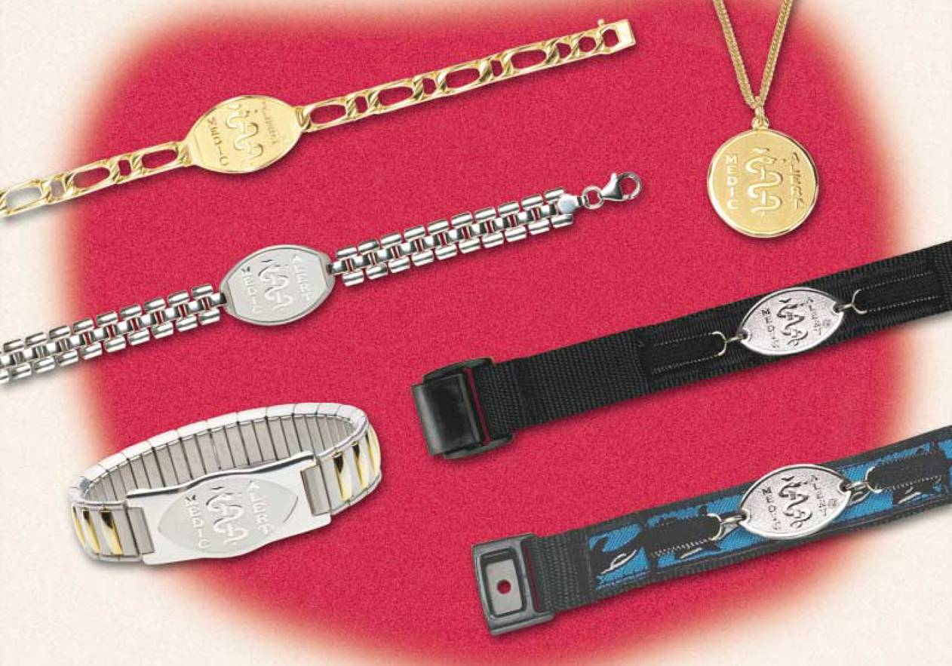
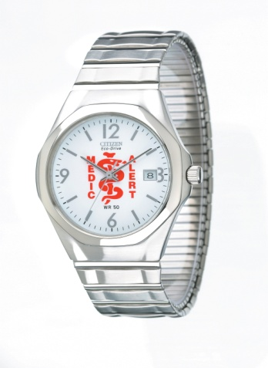
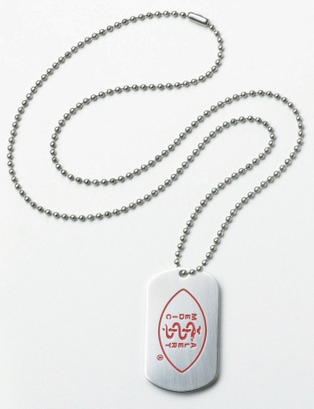
Medical ID Products
Various styles of MedicAlert® identification used internationally
Notes:
It is important that emergency responders are aware that MedicAlert now has a wide range of product styles available to members throughout the world.
MedicAlert products have been in existence for over 45 years. Many people still believe that MedicAlert only offers stainless steel bracelets. In fact as you can see MedicAlert offers a wide variety of products which is important for emergency responders to note when checking for the emblem during an emergency.
All these products are manufactured with the same quality standards and contain the same life saving information as the traditional stainless steel.

Slide 10
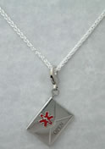
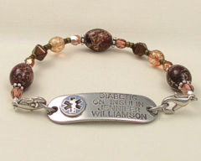
Be Aware of Imitations!
For Patient Safety, all MedicAlert® Medical information in New Zealand is derived from a Registered Medical Professional.
IMITATIONS from jewelery stores, pharmacies or the internet. Problems with the look-alike products:
Accuracy of data questionable (allows self diagnosis)
Information often outdated (no member support service)
No 24-hour Hotline Emergency Call Centre Service
No Electronic Health Record
No direct connection to NZ Ambulance Services
Not endorsed by NZ Medical Professional Organisations
No Emergency Responder training program

Slide 11
Emergency Responders Say
*EMS **CAEP
Saves me time 90% 87%
Helps me establish diagnosis 94% 68%
Helps me determine treatment 83% 73%
Helps me provide treatment 84% 80% more quickly in a life-threatening
situation
Canadian MedicAlert Foundation - National Survey on Medical Emergencies 2001
*Emergency Medical Services (EMS)
** Canadian Association of Emergency Physicians (CAEP)
Notes:
MedicAlert® in Canada now has over One Million Members. In 2001, MedicAlert® undertook research in Canada to understand how effective MedicAlert® was in the field.
In summary, the value of MedicAlert®’s service was rated very highly.
In New Zealand MedicAlert® is widely used, supported and endorsed by registered Medical Professionals.
Medical Professionals acting on their ethical ‘Duty of Care’ refer patients to MedicAlert® on a daily basis throughout New Zealand in the best interests of patient safety.

Slide 12
More Information
Want more information about MedicAlert®?
Website: www.MedicAlert.co.nz
or call MedicAlert® Membership Services Ph. 04 5288 218.
Notes:
MedicAlert® in Canada now has over One Million Members. In 2001, MedicAlert® undertook research in Canada to understand how effective MedicAlert® was in the field.
In summary, the value of MedicAlert®’s service was rated very highly.
In New Zealand MedicAlert® is widely used, supported and endorsed by registered Medical Professionals.
Medical Professionals acting on their ethical ‘Duty of Care’ refer patients to MedicAlert® on a daily basis throughout New Zealand in the best interests of patient safety.
If you would like further information about MedicAlert: go to www.MedicAlert.co.nz or call MedicAlert® Membership Services on 04 5288 218.

